Slide 1
Chevrolet Advanced Design Series Paint Visualizer
Your Dream, Our Solution

Slide 2
Agenda
Project Overview
Resource Overview
Company Overview
Delivery Overview

Slide 3
What is the problem?

Slide 4
Problem Definition:
Lost and Never Found
Custom Design 1947-1955 Chevrolet Trucks
The idea for CADS Paint Visualizer is born

Slide 5
System Justification:
Picture the Dream
Fun
Original Factory Colors vs. Color Wheel

Slide 6
Goals for the system and the project:
Simplicity
Factory and custom colors
one page site

Slide 7
Constraints:
Anti-downloading barrier

Slide 8
User characteristics:
Chevy Advanced Design Series Owners
Anyone can use CADS Paint Visualizer

Slide 9
Agenda
Project Overview
Resource Overview
Company Overview
Delivery Overview

Slide 10
environments:
Development Environment - the software and hardware included in the software engineering lab along with our own personal hardware and software.
Operating Environment - We will be using both Mac’s and PC’s with Internet capability, access to the Siena server, and the latest web browsers.
Maintenance Operating - Maintenance will be done on the same machines where the development of the web application takes place.

Slide 11
Solution strategy:
YDOS will be using the waterfall method of development, with minor variations
Define and Obtain Requirements
Development of Preliminary Design
Development of Detailed Design
Implementation of Software
Testing the Software System
Installation and Maintenance of System

Slide 12
Acceptance criteria:
Users will not be required to log into the system.
The amount of users at one time will not be limited.
CADS Paint Visualizer will be usable on any major browsers.

Slide 13
Sources of information:
Dr. Lederman
Stovebolt.com
Line Drawings

Slide 14
Project Management and development Model:

Slide 15
Agenda
Project Overview
Resource Overview
Company Overview
Delivery Overview

Slide 16
Team structure:
Team Leader – Troy Valle
Project Manager – Frank Schroeder
Technical Processor – Kerrie Daley
Database Manager – Grady McBride
Webmaster – Matt Mainello

Slide 17
Preliminary Staffing and resources:
assigned roles to ensure efficiency
Each member will keep all team members on task
Laptops, Software Engineering Lab Computers
Meetings in Software Engineering Lab

Slide 18
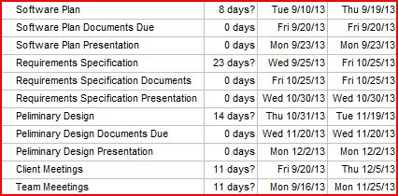
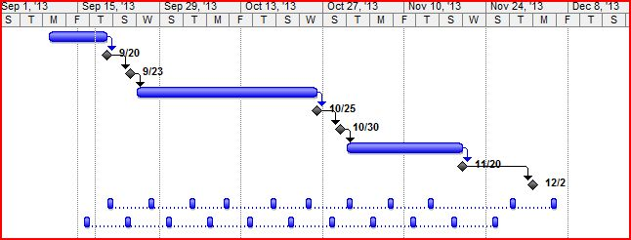
Development schedule:

Slide 19
Project monitoring and control:
Timely Fashion
Meetings weekly with Dr. Lederman
Email with any questions we have about the project
Daily form of communication

Slide 20
Tools and techniques:
Web-hosting sites provided by Dr. Timoth Lederman
Notepad++, DreamWeaver
Modified Waterfall Model

Slide 21
Agenda
Project Overview
Resource Overview
Company Overview
Delivery Overview

Slide 22
Programming languages:
Hypertext Markup Language (HTML)
Cascading Style Sheets (CSS)
Javascript
PHP: Hypertext Processor (PHP)
Structured Query Language (SQL)

Slide 23
Testing requirements:
CADS Paint Visualizer will be tested regularly throughout the development process
Look at every scenario to remove bugs
Non-skilled user testing to receive feedback
Continuous client meetings

Slide 24
Supporting documents:
Software Plan
Requirements Specification
Preliminary Design
Detailed Design
Acceptance Test

Slide 25
Documentation and delivery:
Presentations will be given and documents will be provided to the client as the project progresses
Presentation Dates:
Project Plan: Monday September 23rd
Requirements Specification: Monday October 28th
Preliminary Design: Monday December 2nd
Detailed Design and Acceptance Test: spring 2013

Slide 26
Glossary:
Waterfall Model- a sequential design process involving progression from phase to phase.
notepadd++- a text/source code editor for Windows. Used for programming and scripting languages.
Hypertext Markup Language (HTML)- main markup language for creating webpages.
Cascading style sheets (CSS)- a style sheet language used to make web pages visually appealing.
Javascript- a scripting language that is run on web pages in a browser.
PHP: Hypertext Processor (PHP)- a server-side scripting language used for web development.
Structured Query Language (SQL)- database program designed for managing data.
YDOS- Your Dream, Our Solution; company name.
CADS- Chevrolet Advanced Design Series.

Slide 27
“It is very important to all of us at YDOS that each step of our project gets done in the time that Dr. Lederman has specified. To ensure success in this objective, we will meet with Dr. Lederman weekly and will not hesitate to ask him questions through email, if need be, to keep the project moving forward. Members of YDOS will also have a weekly meeting and will be interacting with one another on a daily basis through any means of communication that we see best fit.”

